Slide 1
Second Life
A new world , a vitual one

Slide 2
TABLE OF CONTENTS
01
02
Introduction
Definitions
03
04
Diffrerence between SL and VR
Second life APIs and Languages
An introduction to virual worlds
What is Second Life?
Some difference between two overlappin domains
The technologies used in second life

Slide 3
TABLE OF CONTENTS
Second Life in education systems
Second life in real life
Architecture, challanges and pitfalls in SL
Conclusion
05
06
The users of second life in the real life
Technics used in education with sl
07
08
Deffirent architectures and problems in sl
This is the end !

Slide 4
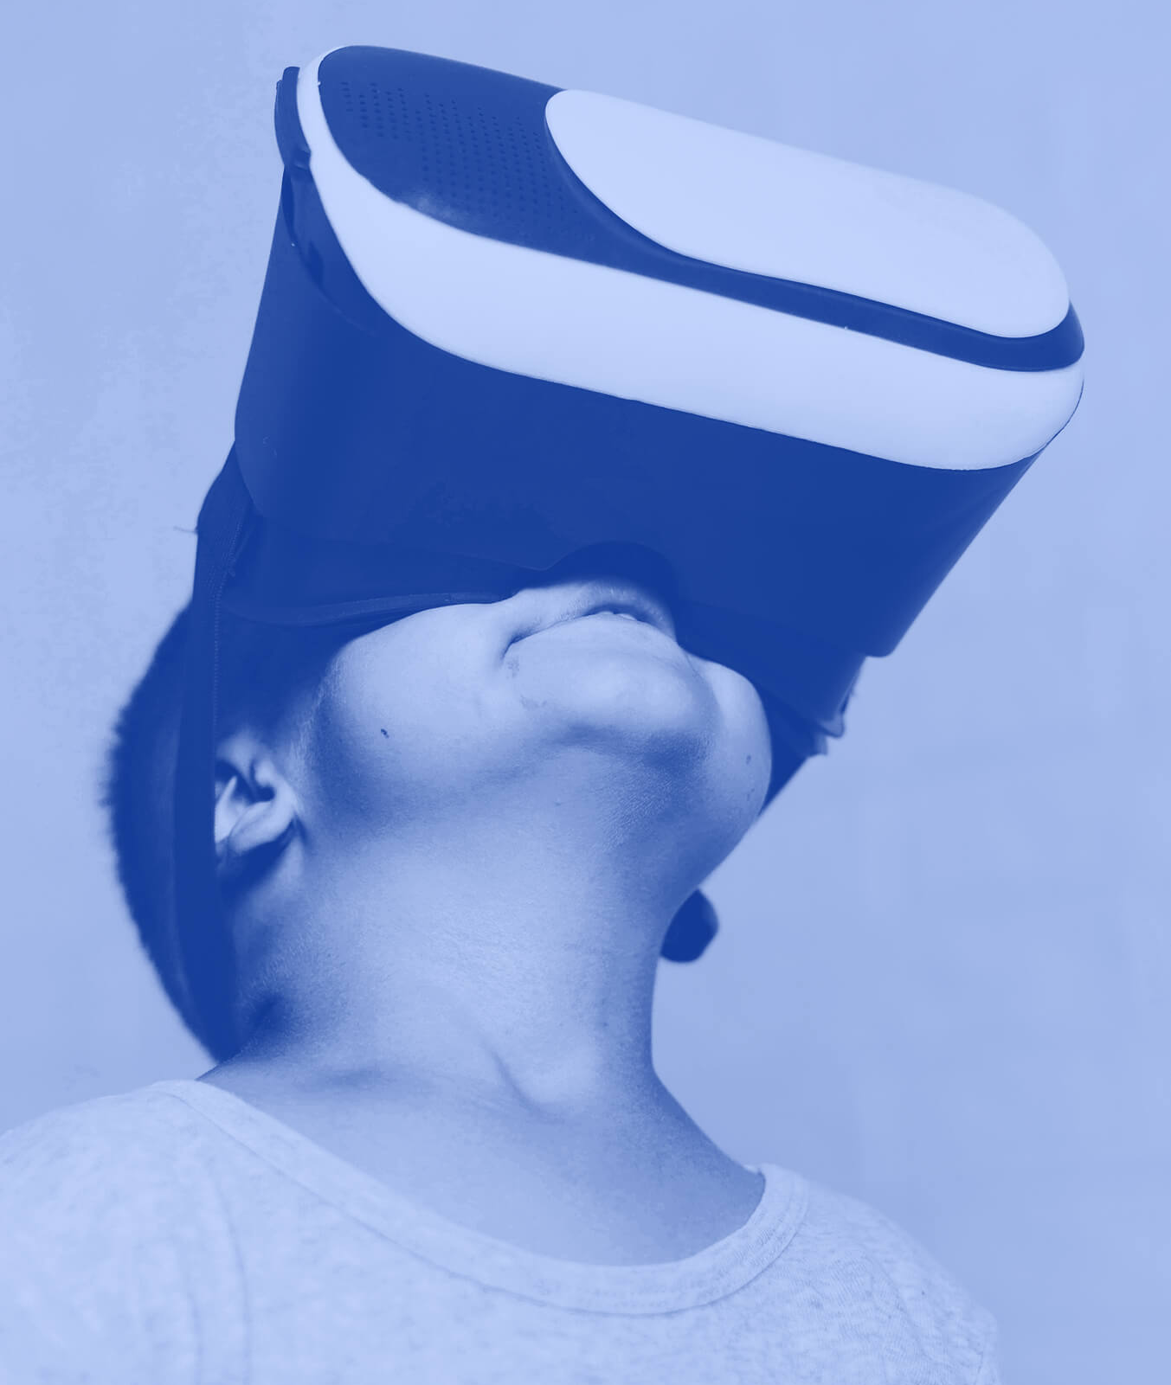
Introduction
Our world has been infected not just with viruses but also with technologie and especially new technologies as virtual reality and virtual words and especially these which lead us to Second Life project which made a qualitative leap in social communication at the beginning of the twentieth century.

Slide 5

What is second life?
Few online social networking sites get as much attention as Second Life (SL), the three-dimensional virtual world where users, called residents, can pretend to be whomever -- or whatever -- they want to be. Although it's an online environment, its influence reaches into the real world -- including a virtual economy that's dependent upon actual money. In reality, or perhaps virtual reality, Second Life is a complex environment filled with potential risks and rewards.

Slide 6


Some definitions
Avatar
Resident
Grid
Lag
a computer user's representation of himself/herself or alter ego
The user who’s charged to create avatars
SL is run on thousands of computer servers, collectively called the Grid
delays in-world caused by slow connections or too many objects in the same place

Slide 7
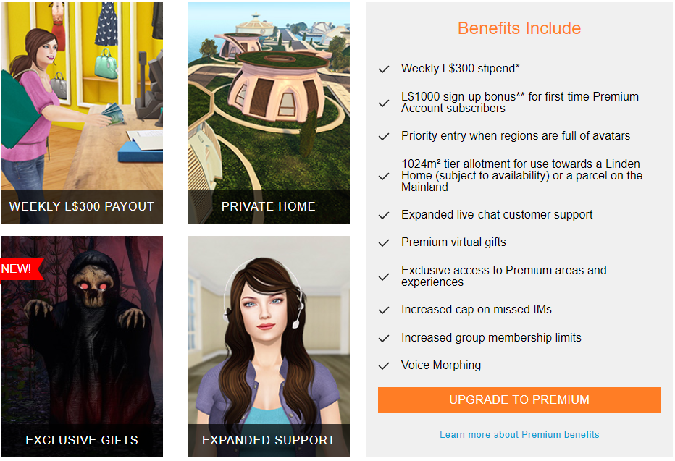
Memberships

Slide 8

Deffirence between SL and VR

Slide 9
“VR is an advanced human-computer interface that simulates a realistic environment and allows participants to interact with it”
Ellis

Slide 10
Deffirence between SL & VR :
01
02
03
No distractions
The 3d effects Is natural
Forced first person view
04
05
Isolation
Vulnerability
In vr the user is actually inside the avatar,
The camera can’t loiter around the avatar’s shoulders, or fly around, or zoom in on in-world objects or displays
While wearing a virtual reality headset, you cant look away, or have the physical world distract you.
this lack of distraction can also lead to is isolation
Playing or watching a scary movie or game ,

Slide 11
Second life APIs and Language
04
technologies

Slide 12
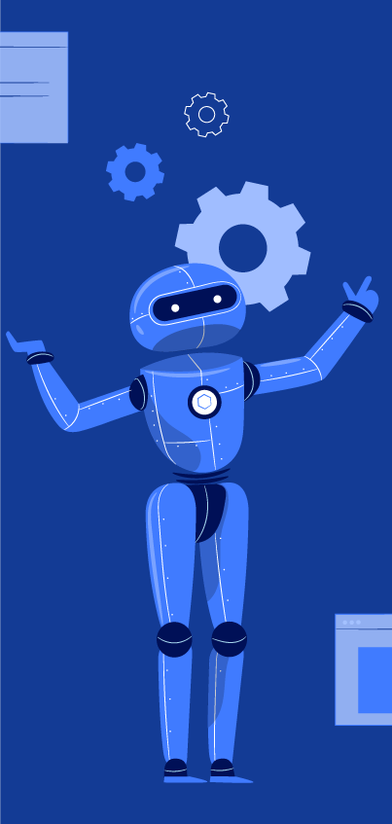
LSL – Linden Sripting Language
LSL stands for "Linden Scripting Language" and is used to script the objects you will encounter and make in Second Life.
LSL is the Linden Scripting Language. This is the language all scripts in Second Life are written in. The structure of LSL is largely based on Java and C, both of which are widely used programming languages in the real world

Slide 13
Second Life API :
Create custom plugins
Register
Embed Maps
The Second Life API allows Users to:
Enables you to register Second Life residents from your web page.
Enables you to embed Second Life Maps onto your web pages.
API used by Second Life Viewer media rendering plugins.

Slide 14
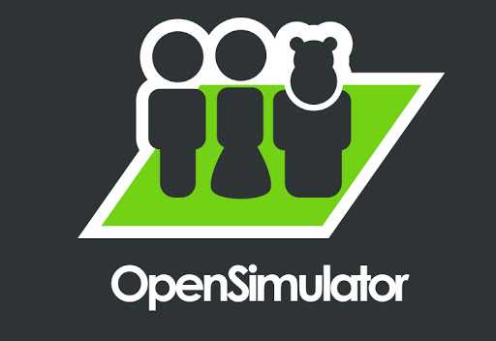
OpenSimulator :

Slide 15
OpenSimulator
OpenSimulator is an open-source multi-platform, multi-user 3D application server. It can be used to create a virtual environment (or world) which can be accessed through a variety of clients, on multiple protocols, see Connecting. Optional Hypergrid allow users to visit other OpenSimulator installations across the web from their 'home' installation or grid. In this way, it is the basis of a nascent distributed Metaverse.

Slide 16
Second life in education systems
05
Study

Slide 17
Second Life in education systems:
Second Life is used as a platform for education by many institutions, such as colleges, universities, libraries and government entities

Slide 18
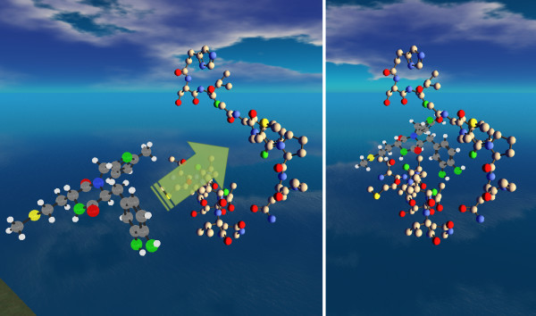
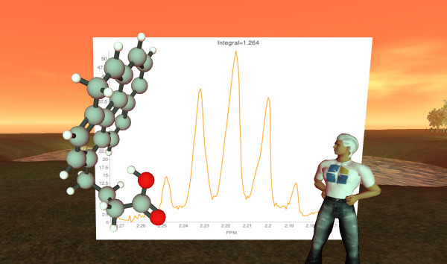
Chemistry :

Slide 19

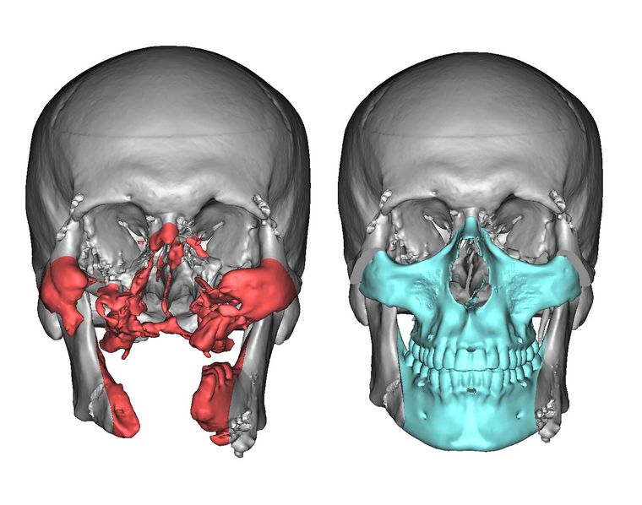
Medicine :

Slide 20
Sloodle :
Sloodle is a combination of Moodle (Learning Management System) and Second Life (virtual world) to create a virtual classroom. Surprisingly, this brilliant tool didn't make it.

Slide 21
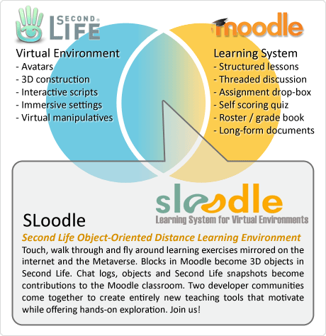
Sloodle :

Slide 22
Sloodle :
Other features include:
Assignment Drop-Box.
Review grades quickly and easily in the standard Moodle gradebook.
Take quizzes in-world with the in-world Quiz Chair, integrated with the Moodle gradebook.
Track points in in-world quizzes and games with the Scoreboard.
Manage scenes of different objects with the Rezzer

Slide 23
Second life in real life
06

Slide 24
SL in real life
Major tech corporations have used Second Life to market products or services to a niche tech-savvy audience. IBM for instance, has purchased 12 islands within Second Life for virtual training and simulations of key businesses processes. Musicians, podcasters and news 9
organizations, including NPR's "The Infinite Mind," the BBC, CNet and the Reuters news agency, have all established a presence within Second Life
Science is no exception and many exhibits in Second Life can be found depicting scientific content.

Slide 25
Architecture, challanges and pitfalls in SL
07

Slide 26
Architecture of Second life
Second Life uses a decentralized server architecture to meet the demands of thousands of users who may be online simultaneously. Rosedale designed the architecture of Second Life to mirror that of the Internet, spreading the virtual environment over thousands of servers in what he describes as a "tiled network."

Slide 27
Challenges and pitfalls:
Second Life faced a significant challenge to potential viability of its virtual economy when a resident released CopyBot, software that allowed the unpaid copying of objects within the MMU. While Second Life took steps to neutralize the issue, the threat of unlimited copies of the intellectual property residents create has been likened to the unlicensed distribution of online content that musicians and filmmakers face.

Slide 28
FUN FACT
Second Life recorded its one millionth resident in late 2006. The year also saw its first real-world millionaire, " Anshe Chung," who parlayed an initial investment of $9.95 USD into over one million dollars over the course of two and a half years. She built her fortune primarily by buying, selling and renting virtual real estate.

Slide 29
Conclusion

Slide 30
Conclusion:
As a conclusion of this research we come to confirm that technologies in general and in special way the new technologies such as virtual worlds and virtual reality and because of projects like the Second Life project, our life has been affected with these technologies which start playing a huge role in every single human in the world and in different domains such as economic systems and health care systems and mostly all life domains and in a special way the educations systems which had our focus.

Slide 31
THANKS
No questions? Okay ☺

